Slide 1


Slide 2
SPRING & FOAM MATTRESS CURRENT SHOP FLOOR PROCESS DETAILS

Slide 3
DAILY CUSTOMER ORDER RECEIVED QTY SPRING - 575 nos CIRRUS - 230 nos TOTAL - 805 nos

Slide 4
CURRENT MACHINARY OUTPUT EFFECENCY
ALL DEPARTMENT PRODUCTION REPORT AS ON 29-09-2025
PRODUCTION | DAY |  |  | NIGHT |  |  | OVERALL
DEPARTMENT | TARGET | ACHIVED | % | TARGET | ACHIVED | % | TARGET | ACHIVED | %
BONNELL COILING | 174960 | 75915 | 43.39% | 174960 | 62005 | 35.44% | 349920 | 137920 | 39%
BONNELL ASSEMBLY | 500 | 229 | 45.80% | 500 | 224 | 44.80% | 1000 | 453 | 45%
POCKETED COILING | 115200 | 83713 | 72.67% | 115200 | 56989 | 49.47% | 230400 | 140702 | 61%
POCKETED ASSEMBLY | 144 | 105 | 72.92% | 144 | 69 | 47.92% | 288 | 174 | 60%
TAILORING | 358 | 302 | 84.36% | 358 | 273 | 76.26% | 716 | 575 | 80%
BORDERING | 3792 | 2454 | 64.72% | 3792 | 2414 | 63.66% | 7584 | 4868 | 64%
QUILTING | 2000 | 2526 | 126.30% | 2000 | 1458.1 | 72.91% | 4000 | 3984.1 | 100%
TAPE EDGE | 550 | 302 | 54.91% | 550 | 307 | 55.82% | 1100 | 609 | 55%
HYPNOS | 200 | 119 | 59.50% | 200 | 124 | 62.00% | 400 | 243 | 61%
OVERALL | 297704 | 165665 | 55.65% | 297704 | 123863 | 41.61% | 595408 | 289285.1 | 48.59%

Slide 5
DAILY PRODUCTION OUTPUT QTY SPRING - 587 nos CIRRUS - 235 nos TOTAL - 822 nos

Slide 6
FAST MOVING VARIETY CYCLE TIME STUDY REPORT
SNO | VARIETY | VARIETY | ADVANCE PLANNING PROCESS TIME | ON LINE PROCESS TIME
1 | COMFORT | BONNELL | 21.57 | 14.10
2 | SUPREME | POCKETED | 21.57 | 12.34
3 | SANIBEL MEMORY PLUS | BONNELL | 21.57 | 15.75
4 | ARDENE MEMORY PLUS | POCKETED | 21.57 | 13.14
5 | SANIBEL ET MEMORY PLUS | BONNELL | 30.57 | 18.75
6 | ARDENE ET MEMORY PLUS | POCKETED | 30.57 | 19.99
 | 78 X 60 | AVG /MIN | 24.57 | 15.68

Slide 7
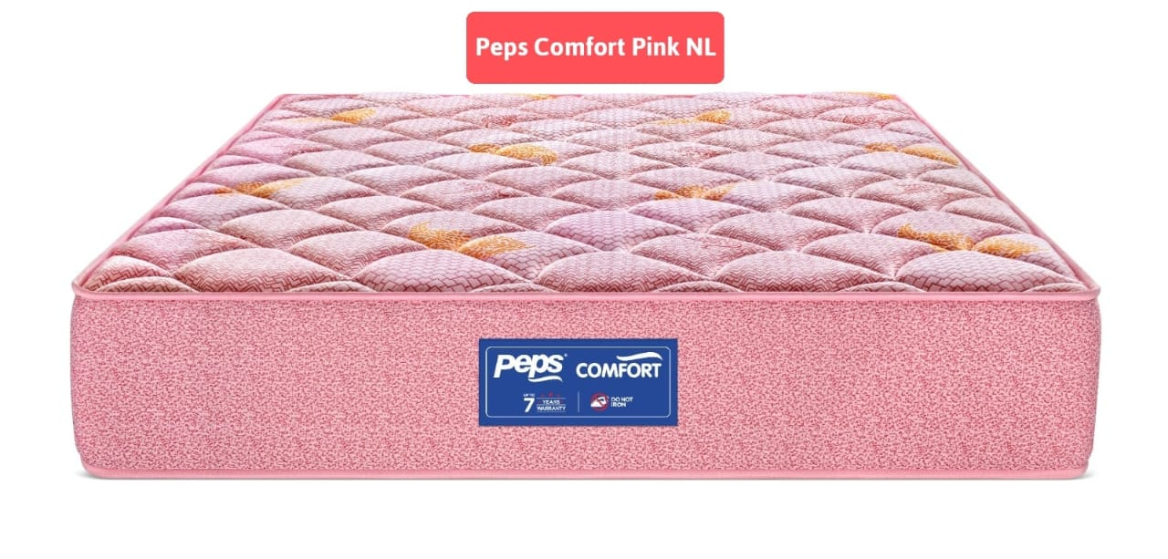
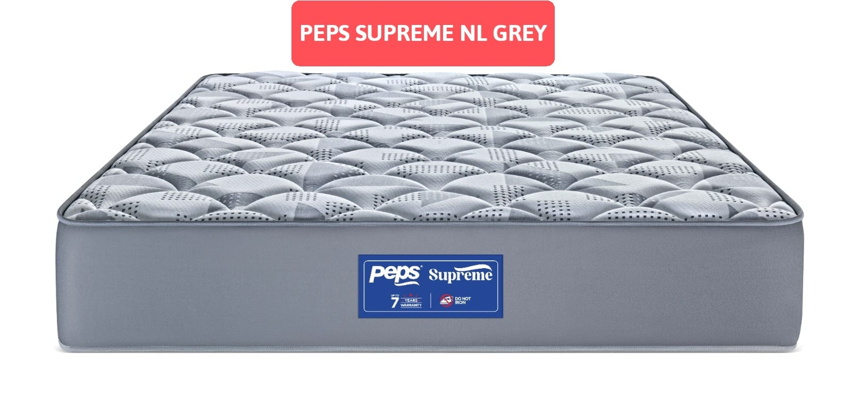
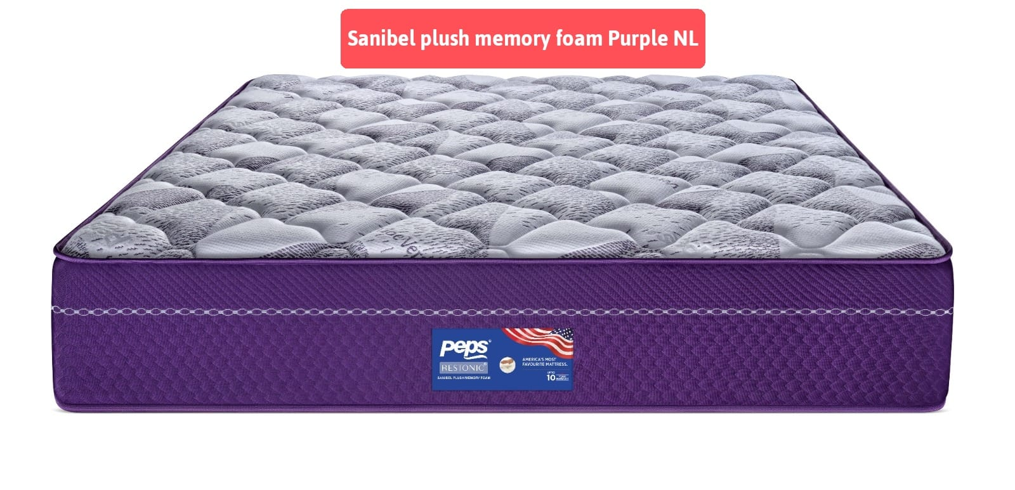
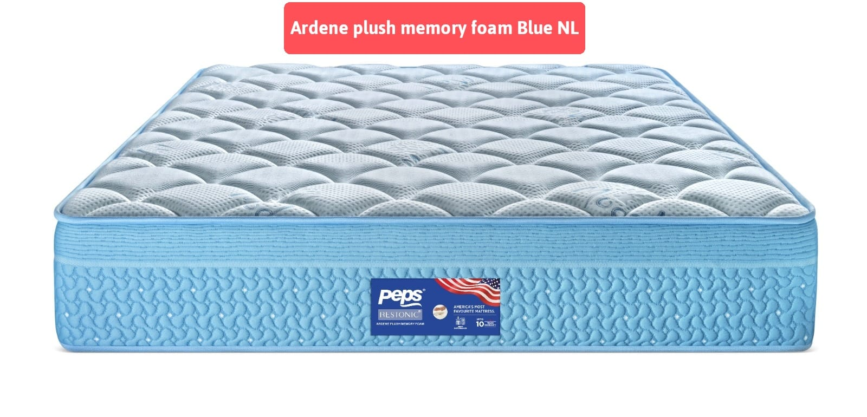

Slide 8
PRODUCTION PROCESS MANPOWER DETAILS
SL.NO | SECTION | QTY
1 | STEEL | 56
2 | QUILTING | 73
3 | TAPE EDGE | 53
4 | CIRRUS | 22
5 | QC | 36
6 | RETURN GOODS | 9
7 | CARPENTRY | 17
8 | MAINTENANCE | 12
9 | DESPATCH | 23
10 | SHIFTING | 20
11 | FOAM CUTTING | 25
 | TOTAL | 346

Slide 9
DAILY AVEARAGE DESPATCH DETAILS NO.OF MATTRESS : 750 NO.OF VEHICLES : 22

Slide 10
CURRENT WORKING MACHINERYS
SPRING UNIT MACHINERY DETAILS (2025)
SL.NO | NAME OF THE MACHINE | MODEL NO | SECTION
1 | BONNEL SPRING TRANSFER-1 | FT-81 | STEEL SECTION
2 | BONNEL SPRING TRANSFER-2 | FT-81 | STEEL SECTION
3 | BONNEL SPRING TRANSFER-3 | FT-81 | STEEL SECTION
4 | BONNEL SPRING TRANSFER-4 | FT-81 | STEEL SECTION
5 | BONNEL COILER | MDC-80 | STEEL SECTION
6 | POCKETED COILER | LR-PS-OV | STEEL SECTION
7 | POCKETED ASSEMBLER | LR-PSA-75P | STEEL SECTION
8 | POCKETED COILER | LR-PS-VS | STEEL SECTION
9 | AUTO POCKETED ASSEMBLER | LR-PSA-98P | STEEL SECTION
10 | BONNEL ASSEMBLER | FA-20 | STEEL SECTION

Slide 11
SPRING UNIT MACHINERY DETAILS (2025)
SL.NO | NAME OF THE MACHINE | MODEL NO | SECTION
11 | QUILTING M/C | RELIANCE M4+ | FABRIC SECTION
12 | PANEL CUTTER | RELIANCE M4+ | FABRIC SECTION
13 | QUILTING M/C | PARAGON M4+ | FABRIC SECTION
14 | PANEL CUTTER | PARAGON M4+ | FABRIC SECTION
15 | QUILTING M/C | (HC3200) | FABRIC SECTION
16 | PANEL CUTTER | HCQGC-C | FABRIC SECTION
17 | FLANGING MACHINE | DS8A | FABRIC SECTION
18 | FLANGING MACHINE | DS-8A | FABRIC SECTION
19 | LONG ARM MACHINE | DC-1 | FABRIC SECTION
20 | RUFFLER MACHINE-1 | PORTER | FABRIC SECTION
21 | RUFFLER MACHINE-2 | PORTER | FABRIC SECTION

Slide 12
SPRING UNIT MACHINERY DETAILS (2025)
SL.NO | NAME OF THE MACHINE | MODEL NO | SECTION
22 | SINGER MACHINE | JUKI | FABRIC SECTION
23 | PATTERN MACHINE | NISHO | FABRIC SECTION
24 | PATTERN MACHINE | NISHO | FABRIC SECTION
25 | BORDER CUTTING & MARKING M/C -1 | PEPS | FABRIC SECTION
26 | BORDER SERGER MACHINE -1 | PEPS | FABRIC SECTION
27 | BORDER STITCHING MACHINE -1 | PEPS | FABRIC SECTION
28 | BORDER SERGER MACHINE -2 | PEPS | FABRIC SECTION
29 | BORDER STITCHING MACHINE -2 | PEPS | FABRIC SECTION
30 | FABRIC SLITER MACHINE | PEPS | FABRIC SECTION
31 | OVERLOCK MACHINE | SIRUBA | FABRIC SECTION
32 | OVERLOCK MACHINE(747K) | JUKI | FABRIC SECTION

Slide 13
SPRING UNIT MACHINERY DETAILS (2025)
SL.NO | NAME OF THE MACHINE | MODEL NO | SECTION
33 | TAPE EDGE MASTER -1, | WB-4, | TAPE EDGE
34 | TAPE EDGE MASTER -2,3 | WB-4, | TAPE EDGE
35 | TAPE EDGE MASTER -4, | WB-4, | TAPE EDGE
36 | TAPE EDGE MASTER -5, | WB-4, | TAPE EDGE
37 | TAPE EDGE MASTER -6 | WB-4, | TAPE EDGE
38 | TAPE EDGE MASTER -7 | WB-4, | TAPE EDGE
39 | TAPE EDGE MASTER -8,9 | WB-5A | TAPE EDGE

Slide 14
SPRING UNIT MACHINERY DETAILS (2025)
SL.NO | NAME OF THE MACHINE | MODEL NO | SECTION
40 | AUTOMATIC BED SEALING | AIR | QC&PACKING
41 | MATTRESS ROLL PACKING | 180305-138 | QC&PACKING
42 | MATTRESS COMPRESSING | MH2322-4 | QC&PACKING
43 | QUALITY CONTROL TABLE CONVEYOR | ET-LQC-FLIP-360" | QC&PACKING
44 | QUALITY CONTROL TABLE CONVEYOR | UMIT MAKINA | QC&PACKING
45 | INTEGRATED MATTRESS TEST MC | HD-F764-D | QC&PACKING
46 | TAPE EDGE MASTER -10 | WB-4, | HYPNOS
47 | OVER LOCK MACHINE | SIRUBA | HYPNOS
48 | SINGER MACHINE | JUKI | HYPNOS
49 | OVER LOCK MACHINE | SIRUBA | CARPENTER
50 | VERTICAL CUTTING | BLADE | RETURNGOODS

Slide 15
FINISHED GOODS STORAGE AREA
SL.NO | STORAGE PLACE | STORAGE AREA (SQ FT) | MATTRESS STORAGE QTY
1 | FACTORY | 15000 | 1500
2 | GODOWN | 24500 | 4500
 | TOTAL | 39500 | 6000

